Slide 1
Lecture: 01
Introductory Concepts on Signals & Systems

Slide 2
Objectives of this Lecture:
To define signal and system
To classify signals
To illustrate different kinds of signal:
Continuous-time and Discrete-time signals
Even and Odd signals
Periodic and Non-periodic signals
Analog and Digital signals
1.2
Notes:
2

Slide 3
What is a Signal?
A signal is a detectable physical quantity (e.g., voice, voltage, current, magnetic field strength etc.) that varies with time, space or any other independent variable by which messages or information can be transmitted.
In the physical world, any quantity exhibiting variation in time (such as voice) or variation in space (such as an image) is potentially a signal that might provide information.
In a RC circuit, the signal may represent the voltage across the capacitor or the current flowing in the resistor.
Mathematically, a signal is represented as a function of an independent variable t which is usually time. Thus, a signal is denoted by x(t).
One-dimensional signal: When the function representing signal depends on a single variable, the signal is said to be one-dimensional. A speech signal is an example of a one-dimensional signal whose amplitude varies with time, depending on the spoken word and who speaks it.
Multi-dimensional signal: When the function representing signal depends on two or more variables, the signal is said to be multi-dimensional. An image is an example of a two-dimensional signal, with the horizontal and vertical coordinates of the image representing the two dimensions.

Slide 4

What is a System?
A system is an organized set of interrelated components working together to accomplish a particular task.
All systems have inputs, outputs and feedback mechanisms.
A system takes a signal as input, performs some processing on that signal and finally produces a signal as output.
A system is a defined by the type of input and output it deals with. The input is known as excitation and the output is known as response.
Signals are meaningless without systems to interpret them, and systems are useless without signals to process.
The interaction between a system and its associated signals is illustrated in the figure below.
In the above figure, input and output both are signals but the input is an analog signal and the output is a digital signal. It means, the system shown in the above figure is actually a conversion system that converts analog signals to digital signals.

Slide 5
Example of Systems
In automatic speaker recognition system, input signal is speech/voice signal, the system is computer, and the output signal is identity of the speaker.
In an aircraft landing system,, the input signal is the desired position of the aircraft relative to the runway, the system is the aircraft, and the output signal is a correct lateral position.

Slide 6
Classification of Signals
Based on different features, six methods of classifying signals are:
Continuous-time signal and Discrete-time signal
Analog signal and Digital signal
Even signal and Odd signal
Periodic signal and Non-periodic signal
Deterministic signal and Random signal
Energy signal and Power signal

Slide 7
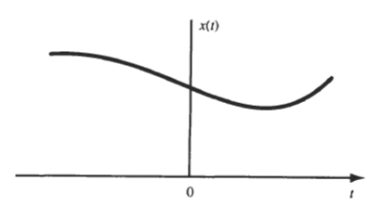
Continuous-time Vs. Discrete-time Signals
Based on the function of time, signals can be classified into two categories:
Continuous-time signal
Discrete-time signal
Continuous-time Signal:
A signal x(t) is said to be a continuous-time signal if it is defined for all time t (i.e., t is continuous time and we can assign to t any unit of time we deem appropriate (e.g., seconds, hours, years, etc.).
A signal is said to be bounded if it has a finite value. A signal is said to be not bounded if it takes on an infinite value. Most of the continuous-time signals we will deal with in the real world are bounded.
Figure shows the graphical representation of a continuous-time signal whose amplitude or value varies continuously with time.
Figure: Continuous-time signal

Slide 8
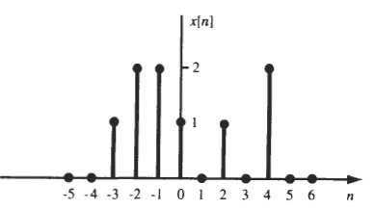
Continuous-time Vs. Discrete-time Signals
Discrete-time Signal:
A discrete-time signal is defined only at discrete instants of time. That is, if the signal x(t) is defined at discrete times, then x(t) is a discrete-time signal.
Since a discrete-time signal is defined at discrete times, a it is often identified as a sequence of numbers, denoted by {x_{n}} or x[n], where n = integer.
Figure shows the graphical representation of a discrete-time signal.
Figure-2: Discrete-time signal

Slide 9
Continuous-time Vs. Discrete-time Signals
Discrete-time Signal (cont…):
A discrete-time signal x[n] is often derived from a continuous-time signal x(t) by sampling it at a uniform rate, such as-
x(t₀), x(t₁), x(t₂),…., x(t_{n}),…,
or in a shorter form as x[0], x[1], x[2]..., x[n], …
or x_{o}, x₁, x₂,…,x_{n},...
Here, x_{n}=x[n]=x(t_{n}) and x_{n},'s are called samples and the time interval between them is called the sampling interval.
When the sampling intervals are equal (uniform sampling), then x_{n}=x[n]=x(nT_{s}), where the constant T_{s} is the sampling interval.

Slide 10
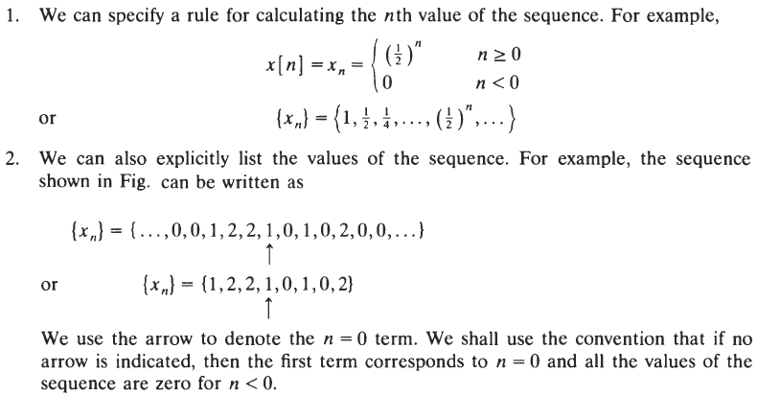
Continuous-time Vs. Discrete-time Signals
Discrete-time Signal (cont…):
A discrete-time signal x[n] can be defined in two ways:

Slide 11
Math
Draw a continuous time signal x(t) = 2 sinΠt where time interval 0<=t<=2.
Sample this continuous time signal with sampling period T = 0.2sec & draw the discrete time signal
Given, x(t) = 2 sinΠt comparing with the wave signal x(t) = A sin Wt
So W = Π or, 2Πf = Π or, 2Π/T = Π or, T = 2 This is the time period of signal
In discrete signal we know, t = nT or, t = 0.2 n
So, x(n) = 2 sin (0.2n Π ) comparing with the wave signal x(t) = A sin Wn
W = 0.2Π or, 2Π/N = 0.2Π or, N = 10
So total 10 samples will be there for this signal. Now create a the data table and draw the signal.
T | 0 | 0.25 | 0.5 | 0.75 | 1 | 1.25 | 1.50 | 1.75 | 2
x(t) | 0 | 1.414 | 2 | 1.414 | 0 | -1.414 | -2 | -1.414 | 0
n | 0 | 1 | 2 | 3 | 4 | 5 | 6 | 7 | 8 | 9 | 10
x(n) | 0 | 1.175 | 1.902 | 1.902 | 1.175 | 0 | -1.175 | -1.902 | -1.902 | -1.175 | 0

Slide 12
Analog Vs. Digital Signals
Based on the taking value over a continuous range or discrete range, signals can be classified into two categories:
Analog signal
Digital signal
Analog Signal:
If a continuous-time signal x(t) can take on any value in the continuous interval (a, b), where a may be minus infinity and b may be plus infinity, then the continuous-time signal x(t) is called an analog signal.
Digital Signal:
If a discrete-time signal x[n] can take on only a finite number of distinct values, then we call this signal a digital signal.

Slide 13
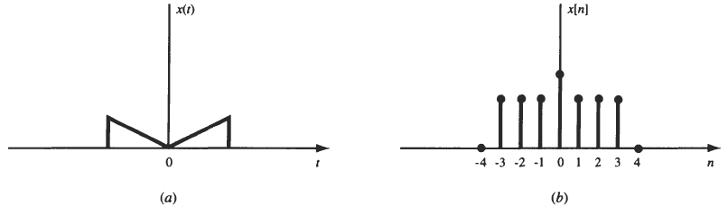
Even Vs. Odd Signals
When we do Time Reversal / folding we get these 2 type of signal:
Even Signal:
A continuous-time signal x(t) or a discrete-time signal x[n] is referred to as an even signal if
x(-t) = x(t) for all t
x[-n] = x[n] for all t
Even signals are symmetric about vertical axis, or time origin.(The horizontal axis in the coordinate plane is called the x−axis. The vertical axis is called the y−axis.)
Identical signal
Figure: Even Signals

Slide 14
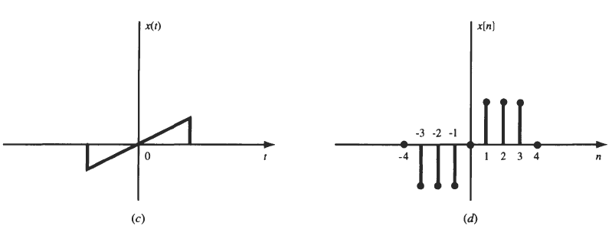
Even Vs. Odd Signals
Odd Signal:
A continuous-time signal x(t) or a discrete-time signal x[n] is referred to as an even signal if
x(-t) = - x(t) for all t
x[-n] = - x[n] for all t
Odd signals are asymmetric about vertical axis, or time origin.
Figure shows the graphical representation of odd signals.
Figure: Odd Signals

Slide 15
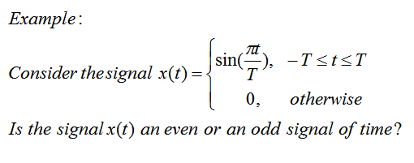
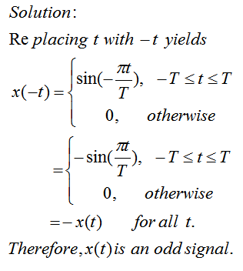
Even Vs. Odd Signals

Slide 16
Even-Odd properties
Properties of Even Signals
The even signals are symmetrical about the vertical axis.
The value of an even signal at time (t) is same as at time (-t).
The even signal is identical with its reflection about the origin.
Area under the even signal is two time of its one side area.
Properties of Odd Signals
The odd signal is antisymmetric about the origin.
The value of odd signal at time (t) is negative of its value at time (-t) for all t, i.e., −∞ < 𝑡 < ∞.
The odd signal must necessarily be zero at time t = 0 to hold 𝑥(0) = −𝑥(0).
Area under the odd signal is always zero.

Slide 17
Even-Odd properties
E * E = E
O * O = E
E * O = O
1 /E = E
1 / O = O
Power(x, E) = E
Power(x, O) = O

Slide 18

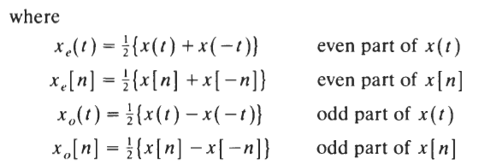
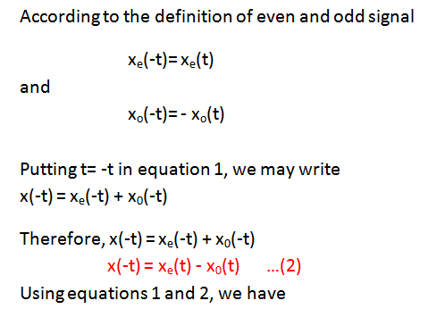


Even-Odd Decomposition of x(t)

Slide 19
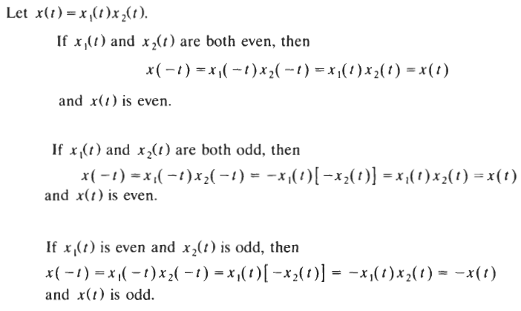
Even Vs. Odd Signals
Example:
Solution:

Slide 20
Even-Odd Maths
Find odd and even component of the following signal:
x(t) = sect + sint + sect sint
We know

Slide 21

Even-Odd Maths
Find odd and even components of the following signal: x(t) = $t^{2}sint −\frac{t^{3}}{\sin^{2}t}$ + $t^{3}cost − \frac{\cos^{3}t}{t^{2}}$ + $\frac{t^{5}}{\sin^{5}t}$
$t^{2}sint$ = E * O = O
$\frac{t^{3}}{\sin^{2}t}$ = O / ( O* O) = O / E = O * 1/E = O * E = O
$t^{3}cost$ =
$$\frac{\cos^{3}t}{t^{2}}$$
$\frac{t^{5}}{\sin^{5}t}$
So, ${ x}_{0}$(t) =
$x_{e}$(t) =

Slide 22
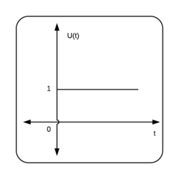
Even-Odd Maths
The unit step signal or function is that type of standard signal which exists only for positive time and it is zero for negative time. In other words, a signal u(t) = 1 when t > 0
u(t) = 0 when t < 0
Find odd and even components of signal x(t) = sint u(t)
U(-t)
-U(-t)

Slide 23

Even-Odd Maths
${ x}_{0}$(t) = { x(t) - x(-t)} / 2
= sint u(t) + sint u(-t) } / 2
= 0.5sint { u(t) + u(-t)}
= 0.5sint [As, u(t) + u(-t) = 1]
$x_{e}$(t) = { x(t) + x(-t)} / 2
= sint u(t) - sint u(-t) } / 2
= sint/2 { u(t) - u(-t)}
Plot a graph, we know -1< sint <1 So, ${ x}_{0}$(t) will be -0.5< sint <0.5

Slide 24
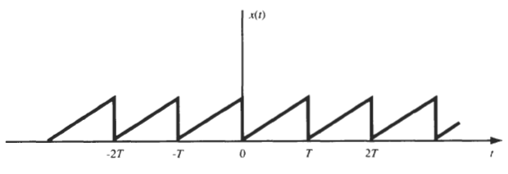
Periodic Signal Vs. Nonperiodic Signals
Periodic Signal:
Signals that repeat over and over are said to be periodic.
A continuous-time signal x(t) is said to be periodic that satisfies the condition
x(t) = x(t+T) for all t
Where T is a positive constant called period of the signal.
Figure shows the graphical representation of a periodic signal.
Clearly, if the above condition is satisfied for T=T₀ (for example), then it is also satisfied for T=2T₀, 3T₀, 4T₀, ….
Therefore, for all t and any integer m, x(t)= x(t+mT) is true for a periodic signal.
Figure: Periodic Signals

Slide 25
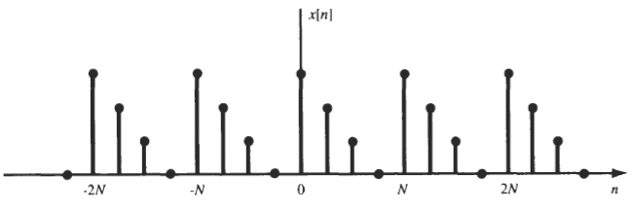
Periodic Signal Vs. Nonperiodic Signals
Periodic Signal:
The smallest positive value of T that satisfies the above condition is called the fundamental period (T₀) of the signal x(t). Accordingly, the fundamental period T₀ defines the duration of one complete cycle of the signal.
The reciprocal of the fundamental period is called the fundamental frequency of the periodic signal x(t) that describes how frequently the periodic signal repeat itself.
Periodic discrete-time signals are defined analogously. A sequence (discrete-time signal) x[n] is periodic with period N if there is a positive integer N for which x[n]= x[n+N] for all n.
An example of discrete-time periodic is given in the figure below. From the figure it follows that x[n]= x[n+mN] for all n and any integer m.
The fundamental period N_{o} of the signal is the smallest positive integer N for which the above condition holds.
Figure: Periodic Signals

Slide 26
Periodic Signal Vs. Nonperiodic Signals
Nonperiodic Signal:
The definition of periodic signal given before does not work for a constant signal x(t) (known as a dc signal).
For a constant signal x(t) the fundamental period is undefined since x(t) is periodic for any choice of T (and so there is no smallest positive value).
Any continuous-time signal which is not periodic is called a nonperiodic or aperiodic signal.
Note
The sum of two continuous-time periodic signals may not be periodic but that the sum of two periodic discrete-time signals is always periodic.

Slide 27
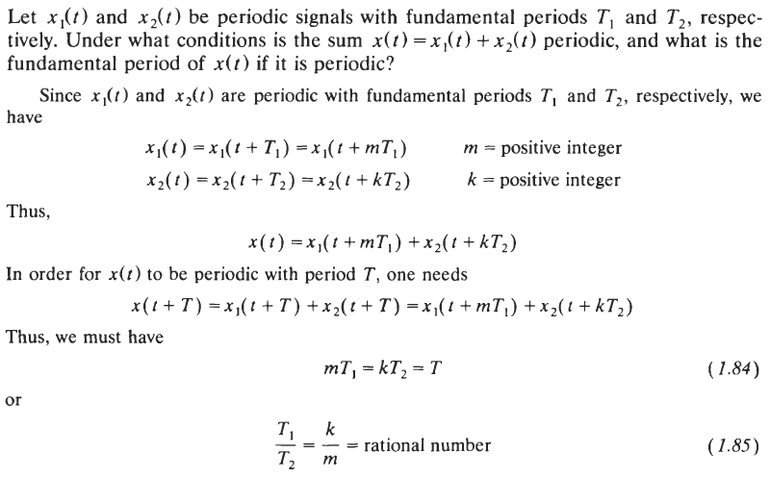
Periodic Signal Vs. Nonperiodic Signals
Example-1:

Slide 28
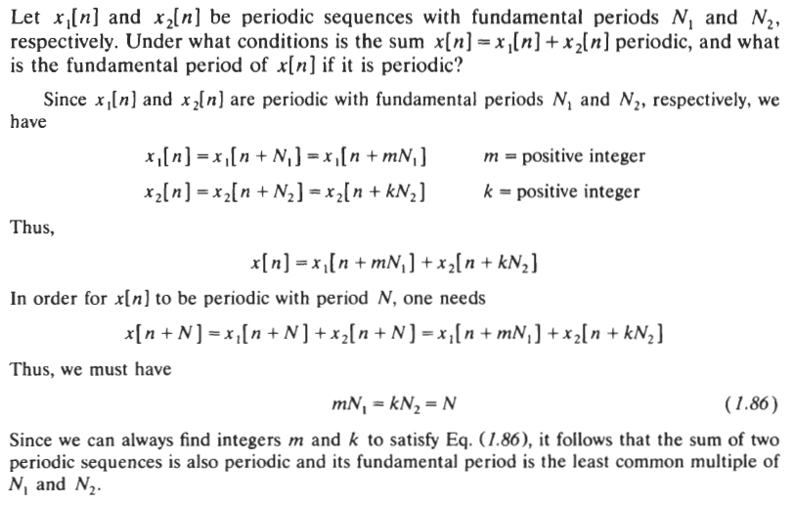
Periodic Signal Vs. Nonperiodic Signals
Example-2:

Slide 29
Periodic - Nonperiodic Math
Find if the signal is periodic and what it’s fundamental period
x(t) = 5cos(200Πt)
Comparing this with standard cosine signal x(t) = Acos(2Πft) we get
2Πf = 200Π
Or, f = 100 Hz
So, T = 1/ 100 = 0.01s = 10ms
Given signal is periodic with period T = 10ms (Ans)

Slide 30
Periodic - Nonperiodic Math
Find if the signal is periodic and what it’s fundamental period
ii. x(n) = 12sin(25Πn)
Condition for a Discrete time signal to be periodic is to be f = k/N
Frequency should be ratio of 2 integer values
Comparing this with standard cosine signal x(n) = Acos(2Πfn) we get
2Πf = 25Π
Or, f = 25/2 Hz [Hence holds the condition k/N]
So given signal is periodic with N = 2 samples per cycle (Ans)

Slide 31
Periodic - Nonperiodic Math
Find if the signal is periodic and what it’s fundamental period
iii. x(t) = 3cos(4t + Π/4)
We know if x(t) = x(t+T) it’s a periodic signal
And cos is periodic for 2Π fundamental period
So, 3cos(4(t+T) + Π/4) = 3cos(4t + Π/4 + 2Πk)
Or, 3cos(4t+ 4T) + Π/4) = 3cos(4t + Π/4 + 2Πk)
Or, 4T = 2Πk
Or, T = Π/2
Given signal is periodic with period T = Π/2 (Ans)

Slide 32
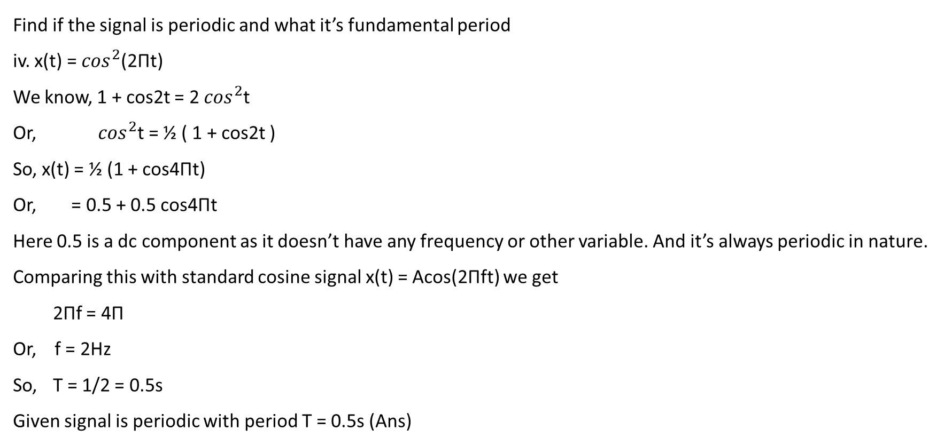
Periodic - Nonperiodic Maths
Find if the signal is periodic and what it’s fundamental period
iv. x(t) = $\cos^{2}$(2Πt)
We know, 1 + cos2t = 2 $\cos^{2}$t
Or, $\cos^{2}$t = ½ ( 1 + cos2t )
So, x(t) = ½ (1 + cos4Πt)
Or, = 0.5 + 0.5 cos4Πt
Here 0.5 is a dc component as it doesn’t have any frequency or other variable. And it’s always periodic in nature.
Comparing this with standard cosine signal x(t) = Acos(2Πft) we get
2Πf = 4Π
Or, f = 2Hz
So, T = 1/2 = 0.5s
Given signal is periodic with period T = 0.5s (Ans)

Slide 33
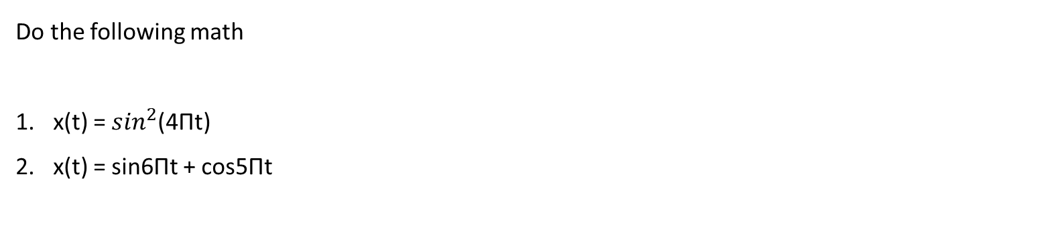
Periodic - Nonperiodic Math
Do the following math
x(t) = $\sin^{2}$(4Πt)
x(t) = sin6Πt + cos5Πt

Slide 34
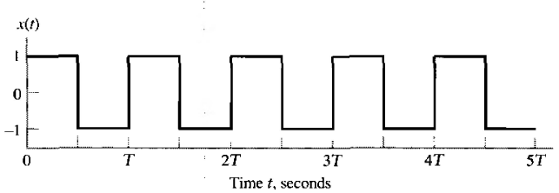
Deterministic Vs. Random Signals
Deterministic Signal:
Deterministic signals are those signals whose values are completely specified for any given time.
Thus, a deterministic signal can be modeled by a known function of time t.
The square wave signal shown below is an example of a deterministic signal.
Figure: Deterministic Signal

Slide 35
Deterministic Vs. Random Signals
Random Signal:
Random signals are those signals that take random values at any given time and must be characterized statistically.
In random signal, there is uncertainty before its actual occurrence.
The noise generated in the amplifier of a radio or television receiver is an example of a random signal. Its amplitude fluctuates between positive and negative values in a completely random fashion.
The EEG signal is also an example of a random signal.

Slide 36
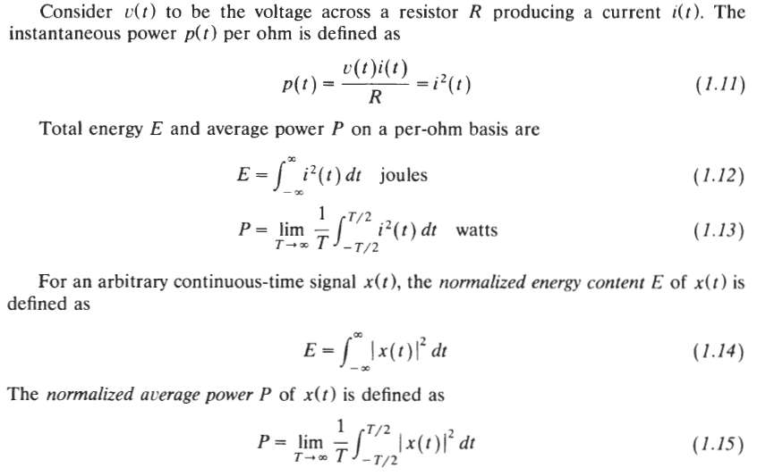
Power Vs. Energy Signals

Slide 37
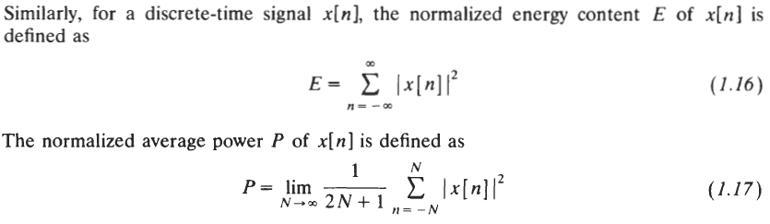
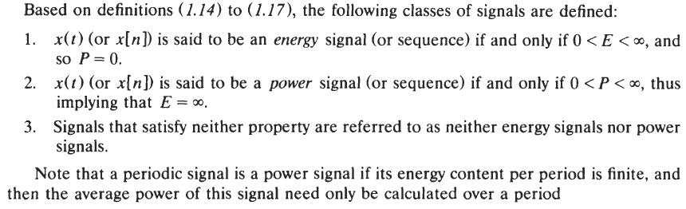
Power Vs. Energy Signals

Slide 38
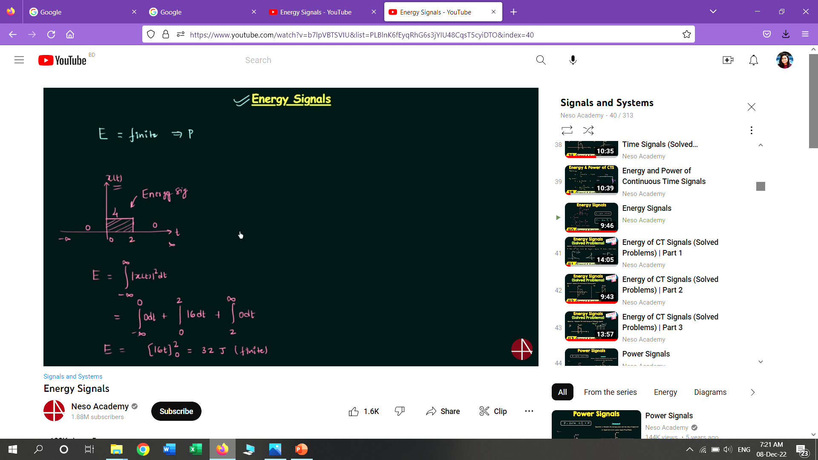
Power- Energy Maths
Avg power = Total power / total time
= p (t) / infinite
= 0

Slide 39
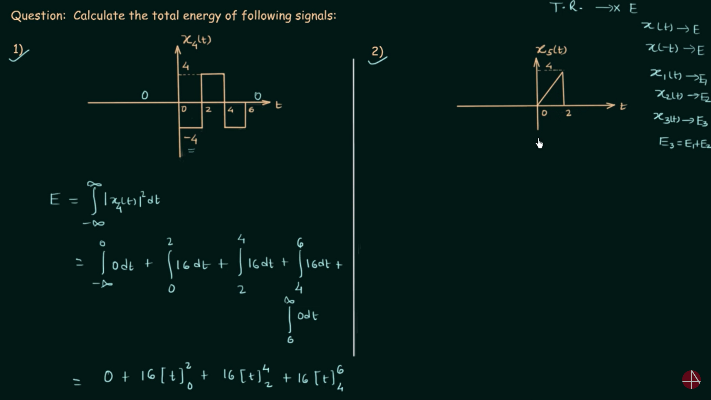
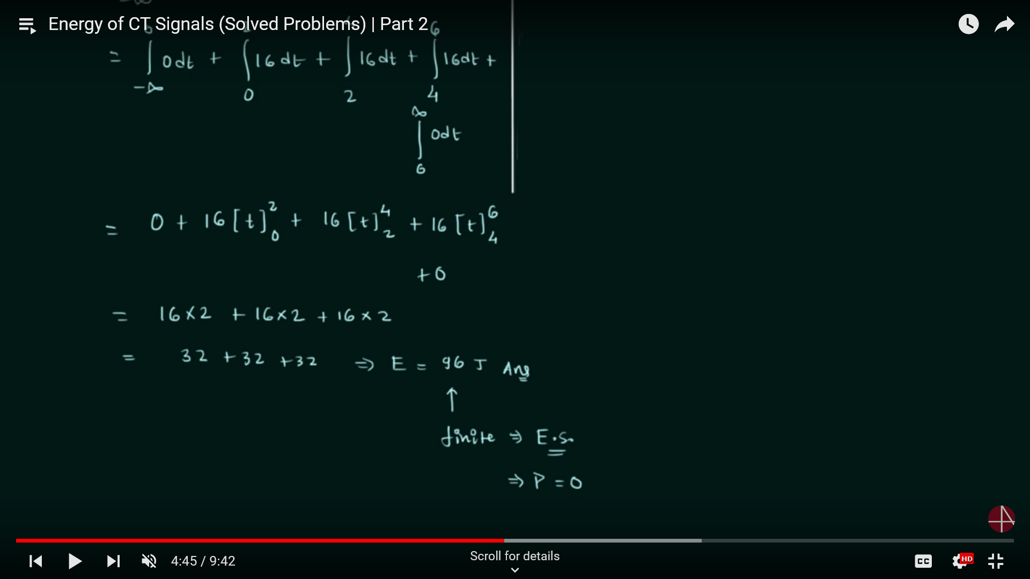
Power- Energy Maths

Slide 40
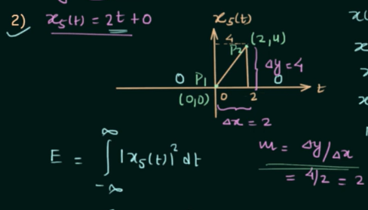
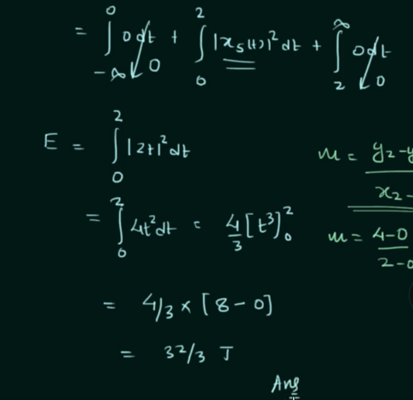
Power- Energy Maths

Slide 41
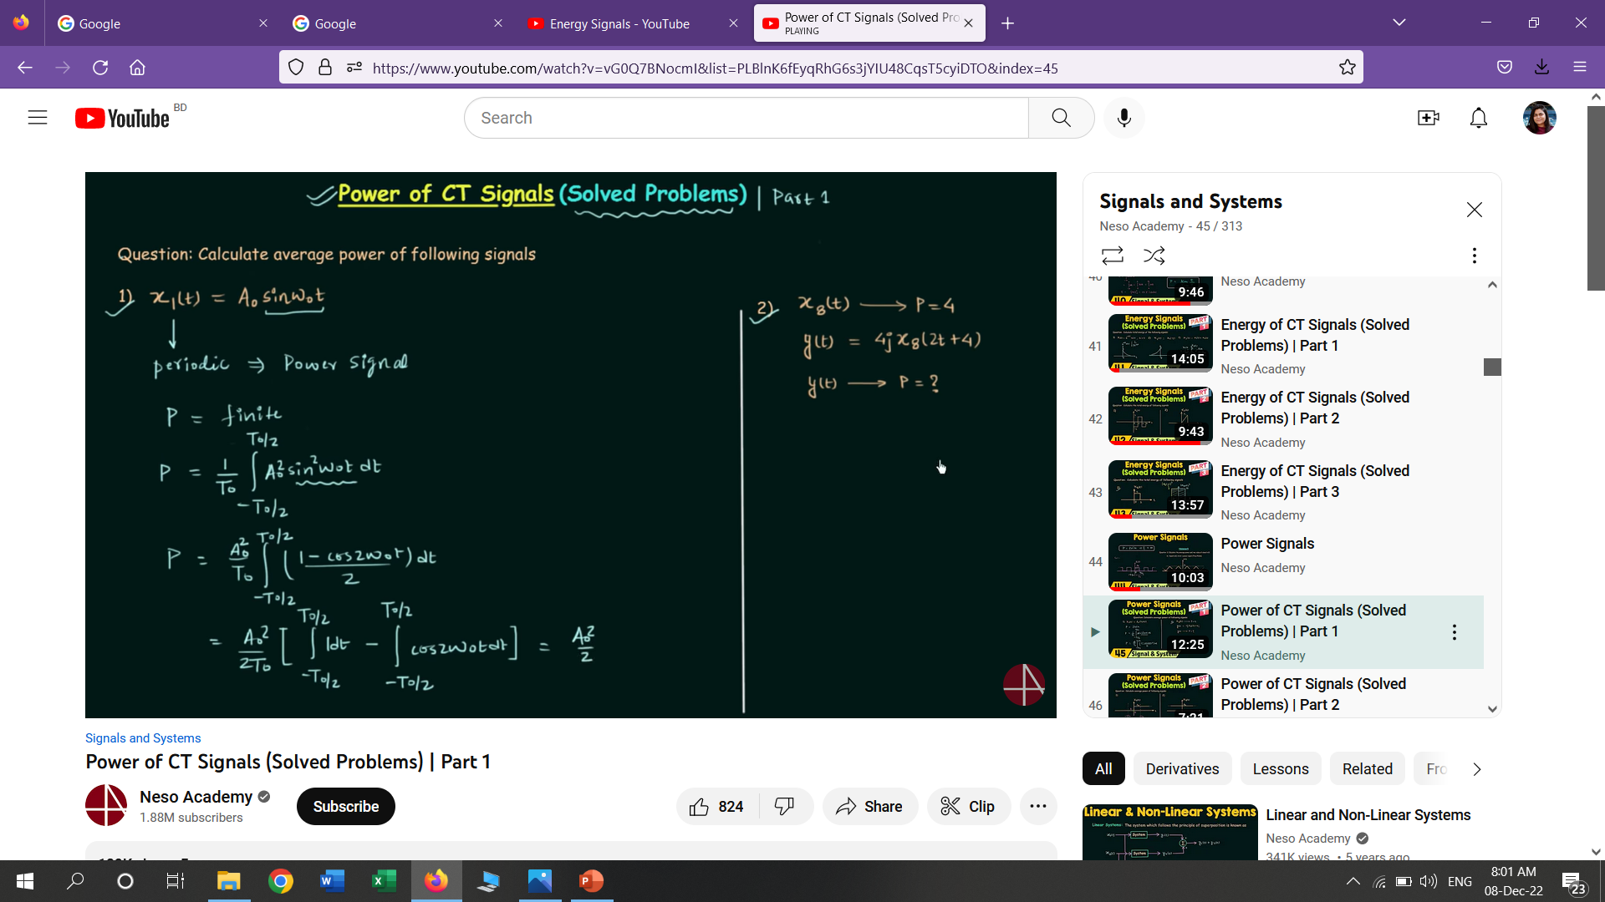
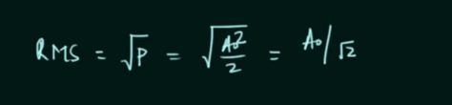
Power- Energy Maths

Slide 42
Schaum's Outline of Signals and Systems
1.1, 1.2, 1.6, 1.9, 1.10, 1.13, 1.14, 1.16, 1.20

Slide 43
Thank You

